Slide 1
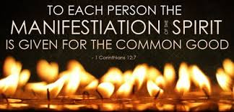
Empowered to know and to serve God.

Slide 2
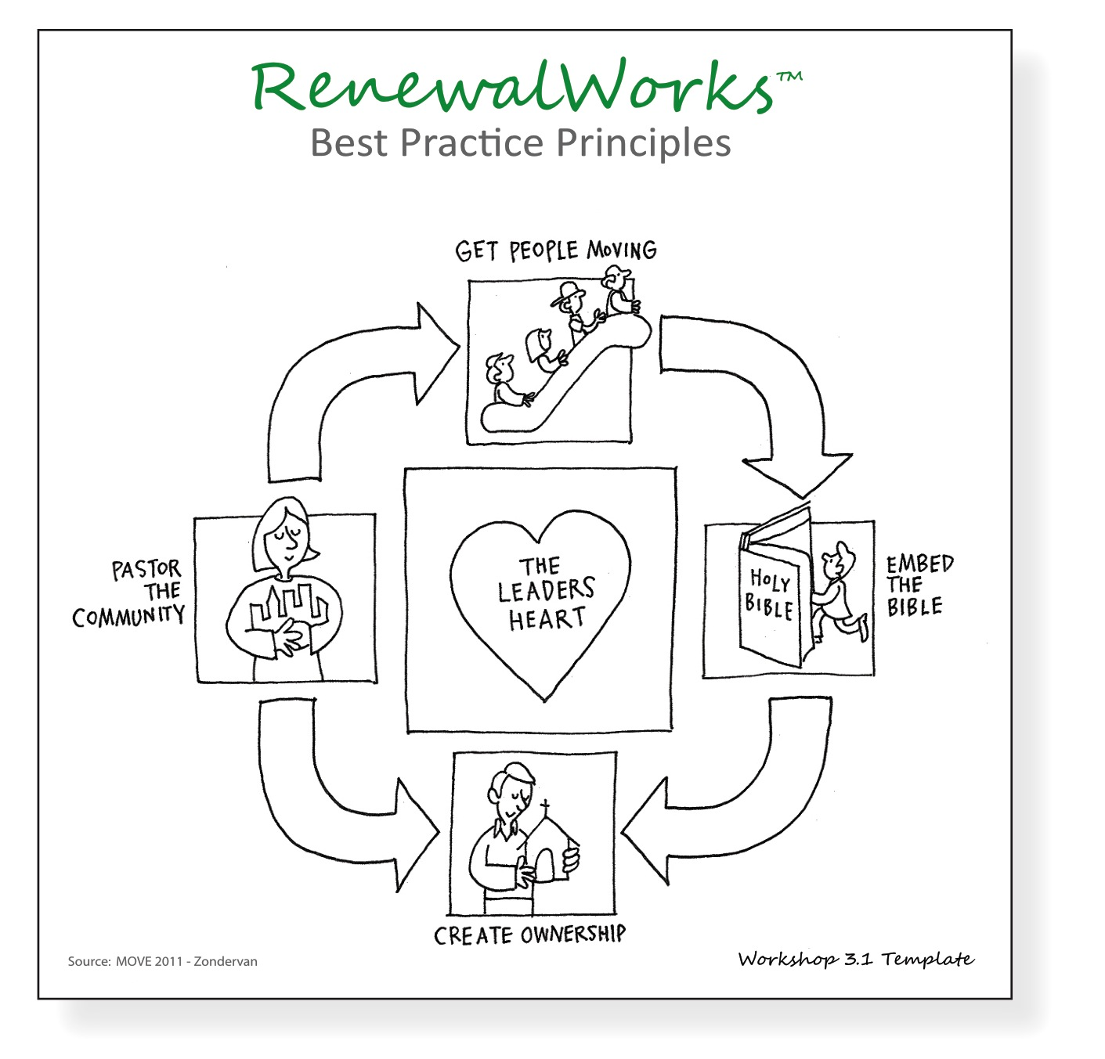
Learning about your spiritual gifts is creating ownership of your own ministry and building up your leadership heart.

Slide 3
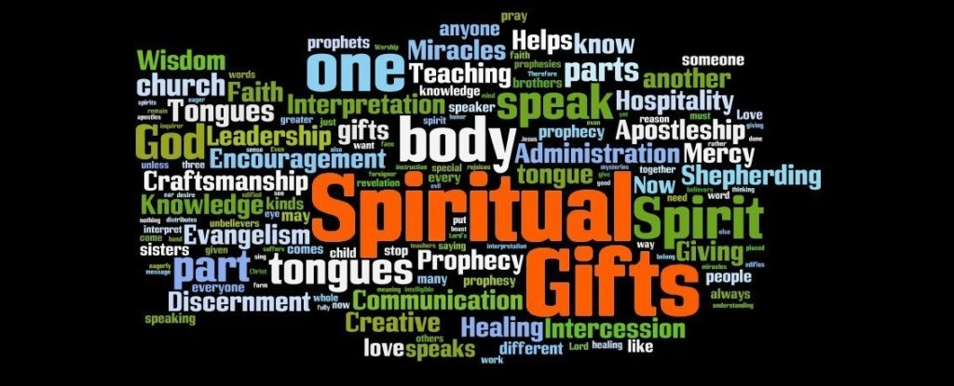

Slide 4
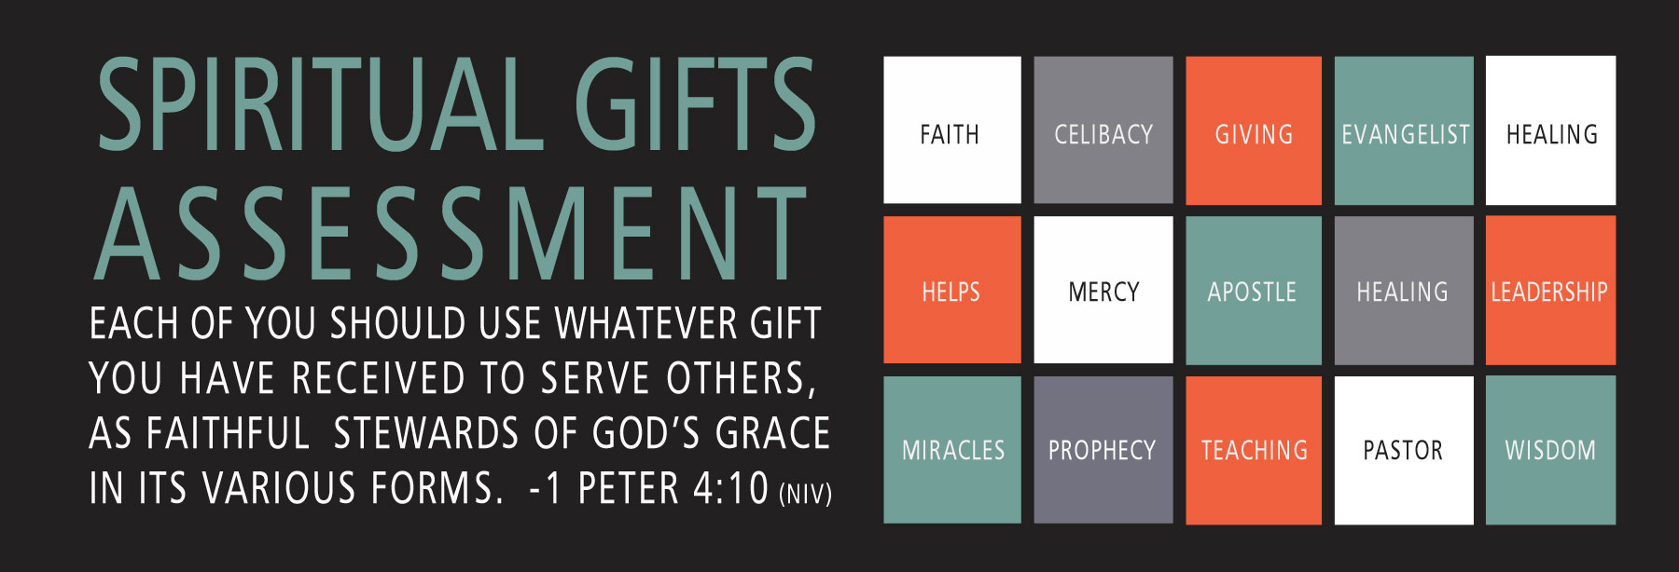

Slide 5
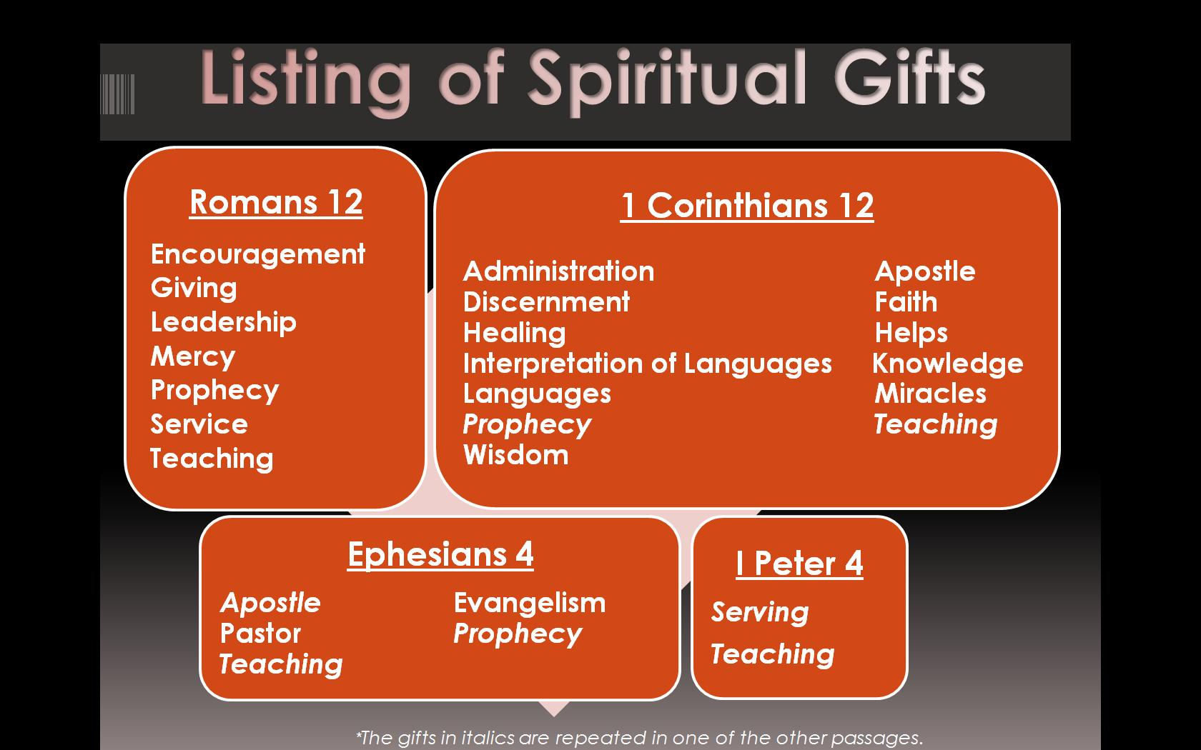

Slide 6
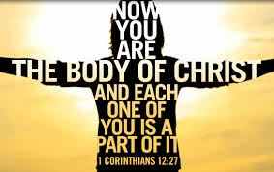
Only one person had all the gifts, Jesus. When we act in one accord we become the body of Christ, fully gifted, and Jesus’ life and love is made manifest in our midst.

Slide 7


Slide 8
1 Corinthian’s 12: 1 - 11
There are many gifts…
There are many types of service…
There are many types of activities…
Same Spirit,
The same Lord,
The same God, who activates them in everyone.

Slide 9


The Spiritual Gifts are to be used to:
Build up the body of Christ
Serve the world that God loves

Slide 10
To get the big picture: three parts, make a whole ministry picture:
Passion: God given passion is the place we are compelled to make a difference. Indicates where we will serve.
Personal Style: MBTI is your God given style preference for how you will serve. (16personalities.com)
Spiritual Gifts: God’s power moving in you to serve the church and the world God loves. Gifts indicate what you will be doing when you serve. (https://spiritualgiftquiz.org/)

Slide 11
There is no right or wrong passion, gift or style. We are made for a purpose:
Passion: When you serve in the area of your passion you will feel God’s motivation, energy and direction.
Spiritual Gifts: When you serve in your gifts you serve more competently, effectively and feel the companionship and empowerment of the Holy Spirit.
Personal Style: When you serve according to your personal style you feel more confident, fulfilled and effective.

Slide 12
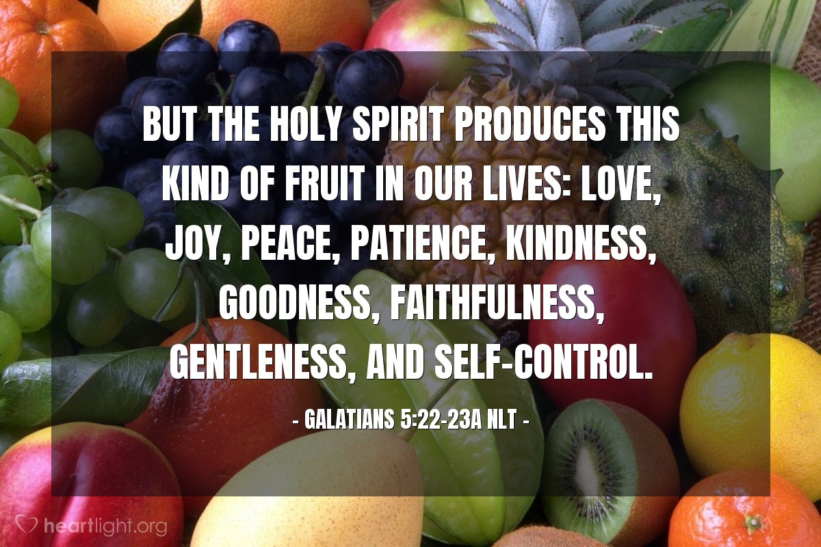
When gifts, and passions, and styles are expressed in the pursuit of spiritual maturity, the fruits of the Holy Spirit, Christian grace, and love, are present:

Slide 13
The Spiritual Gifts are not:
Skills or talents.
Are not roles.
They are not offices.
Not the fruit of the spirit.
Not for self gain.
Not the same for everyone.
Gifts are not given fully developed, we must attend to them.

Slide 14
Spiritual Gifts are:
Unmerited blessing…they can’t be earned, just given.
Are job descriptions for ministry.
Means for discovering God’s will.
Guarantees of effective service.
Life-giving and joyful.
An embodied experience of the presence and power of God.

Slide 15
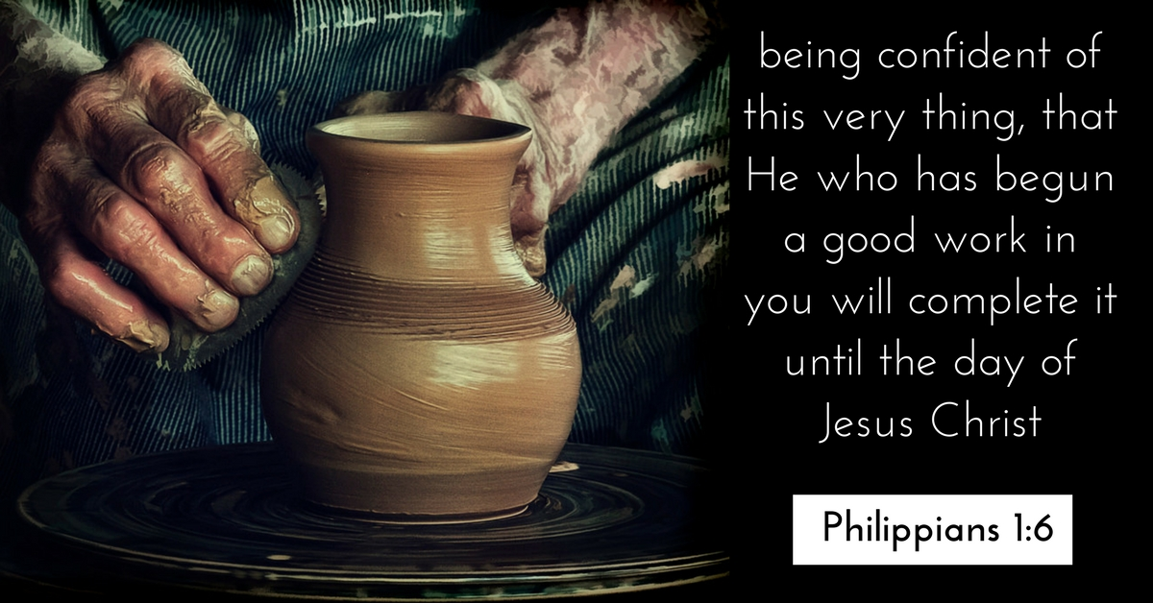
Your Passion, Style, and Gifts are your Spiritual DNA.

Slide 16


Slide 17
Get it done gifts
Administration
Helps/Service
Giving/Liberality
Crafting/Makers
Stewardship

Slide 18
Nurture/Connectors Gifts
Hospitality
Mercy/Compassion
Community Builder

Slide 19
Intervention Gifts
Healing
Intercessory Prayer
Faith

Slide 20
Guidance Gifts
Exhortation
Encouragement
Wisdom
Knowledge
Prophecy
Discernment

Slide 21
Communication Gifts
Teaching
Evangelist
Music/Worship Leader
Creative Communication

Slide 22
Authority Gifts
Leadership
Apostleship/Church Planter
Missionary
Pastor

Slide 23

In groups of three discuss:

Slide 24

In groups of three discuss: What subjects would keep you up talking all night?
all night

Slide 25

When you see this issue you feel deep inside someone should do something! What is it?

Slide 26
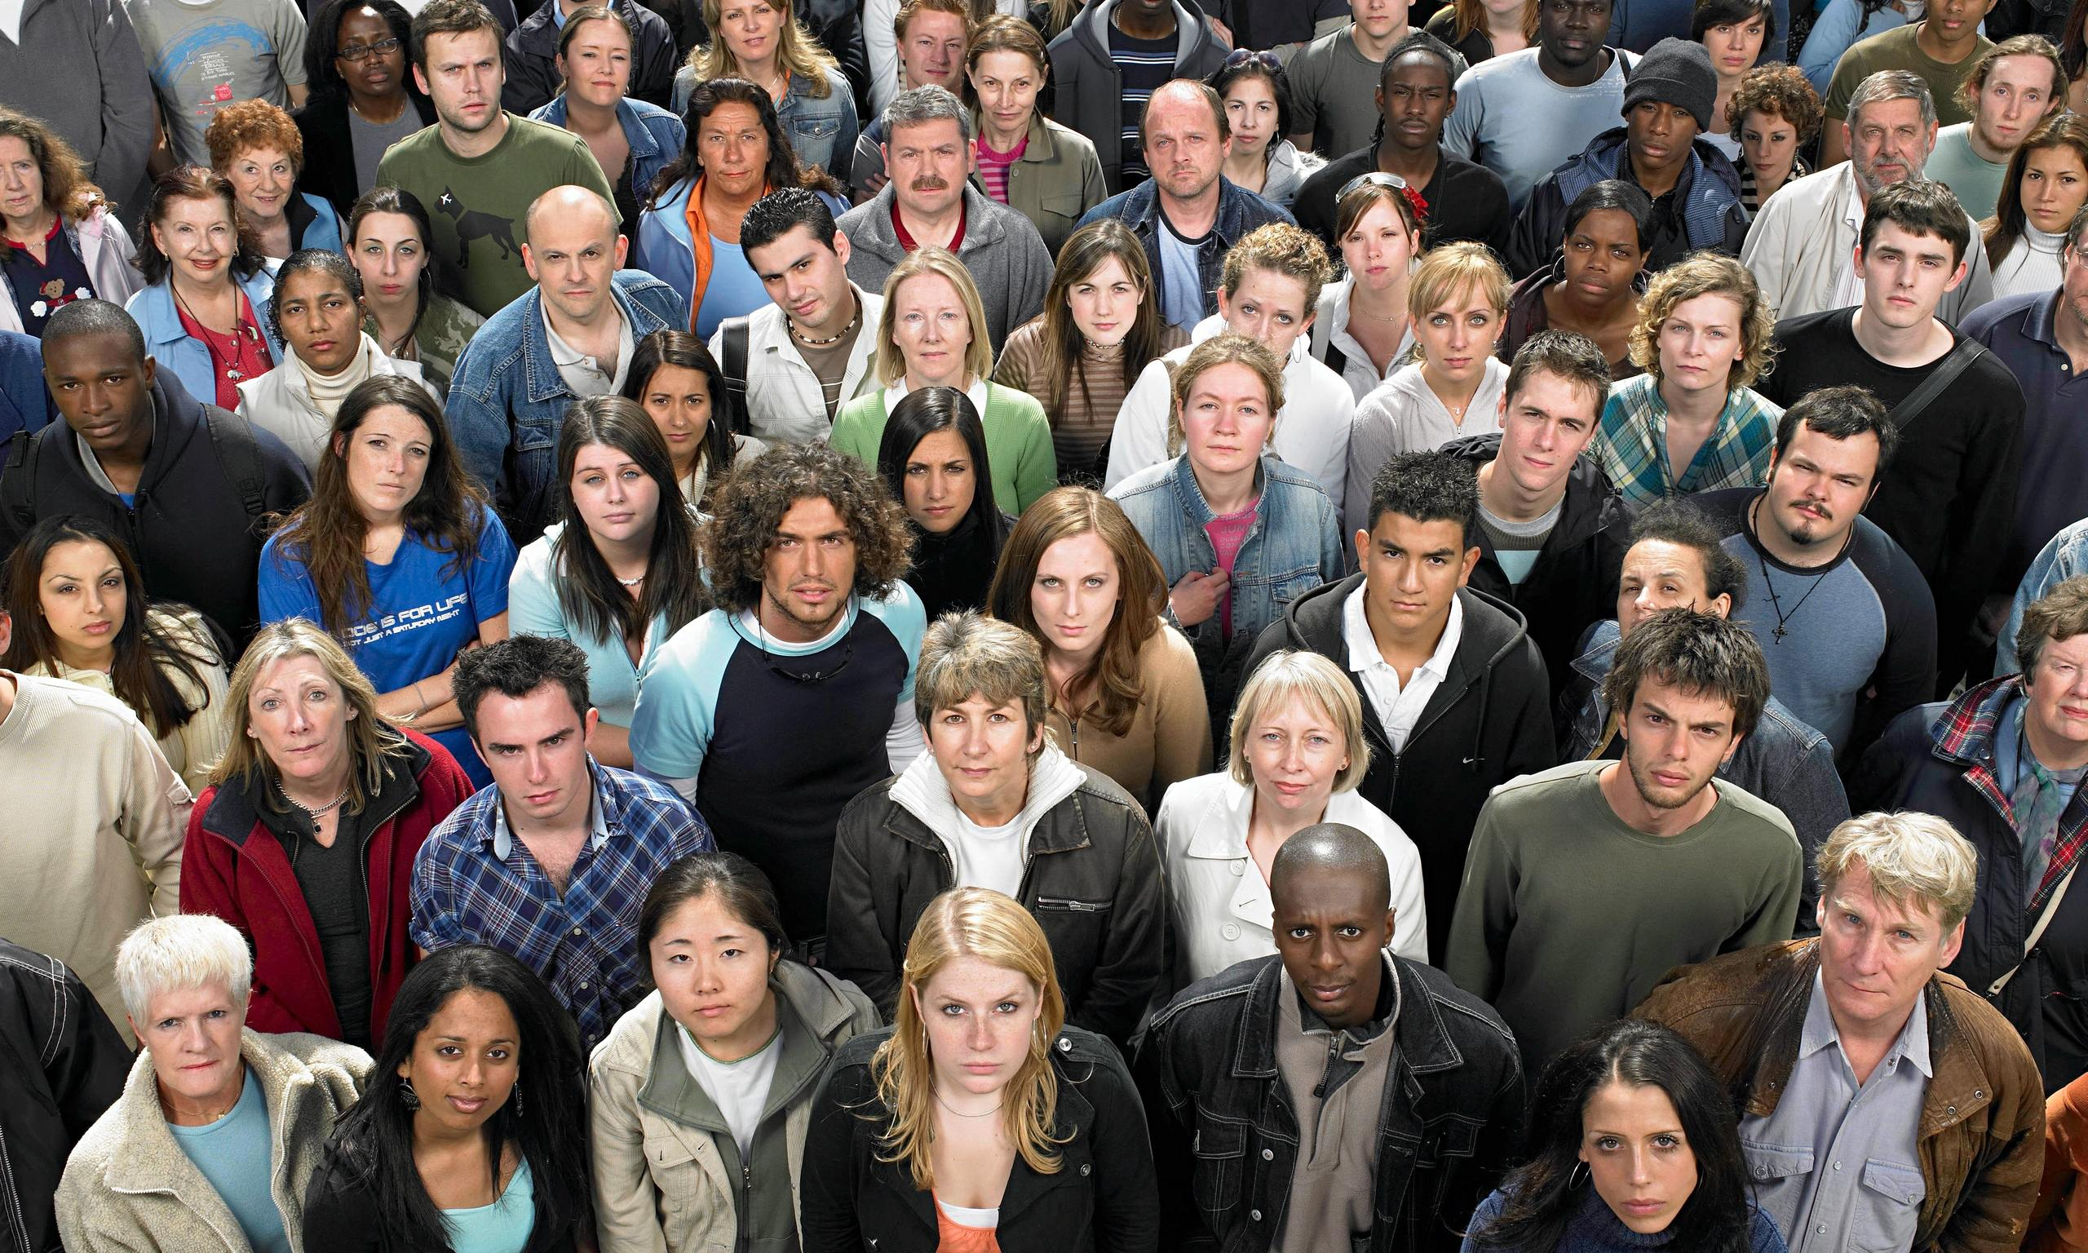
Who are you drawn to minister with, who does God wish to touch through you?

Slide 27
Gift Groups
Get it Done Gifts
Nurture Fellowship Gifts
Administration
Helps/service
Giving
Craftmanship
Stewardship
Hospitality
Mercy/Compassion
Community Builder
Faith

Slide 28
Gift Groups cont.
Intervention Gifts
Guidance Gifts
Healing
Miracles
Intercessory Prayer
Exhortation/Discipleship
Exhortation/Encouragement
Wisdom
Knowledge
Prophecy
Discernment

Slide 29
Gift Groups cont.
Communication Gifts
Authority Gifts
Teaching
Music
Evangelism
Tongues
Interpretation of Tongues
Creative Communication
Leadership
Apostleship/Church Planter
Missionary/Discipleship
Pastor

Slide 30
Note your highest scoring gift, go to the Gift Group areas signed around the room. Share together:
Your experience of when, where and how you have used this gift.
Who did you use the gift with?
How did it feel?
Did it remind you of other experiences?
Any experience of special empowerment in exercising this gift?
Are you experiencing any leading from the Holy Spirit on next steps in ministry with this gift?

Slide 31
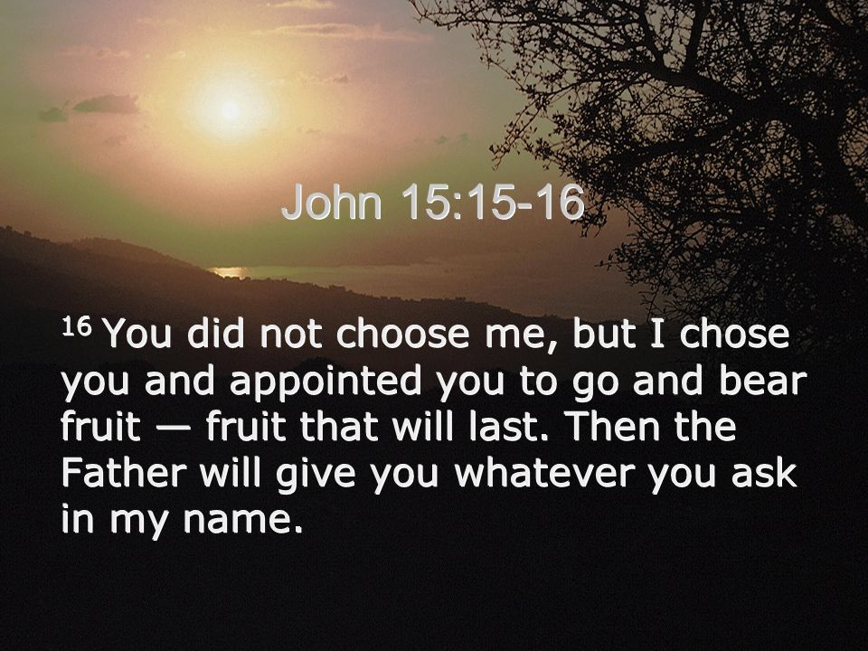

Slide 32
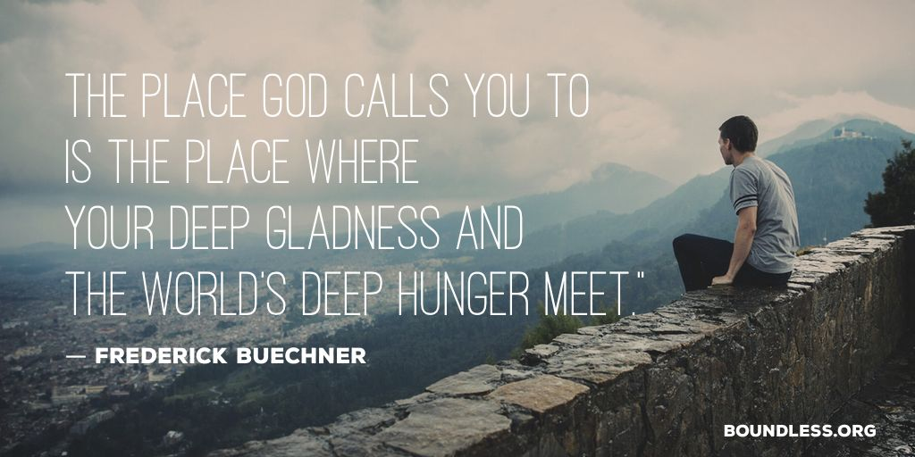
Take a moment to examine what you have written down, where might God be calling you?

Slide 33
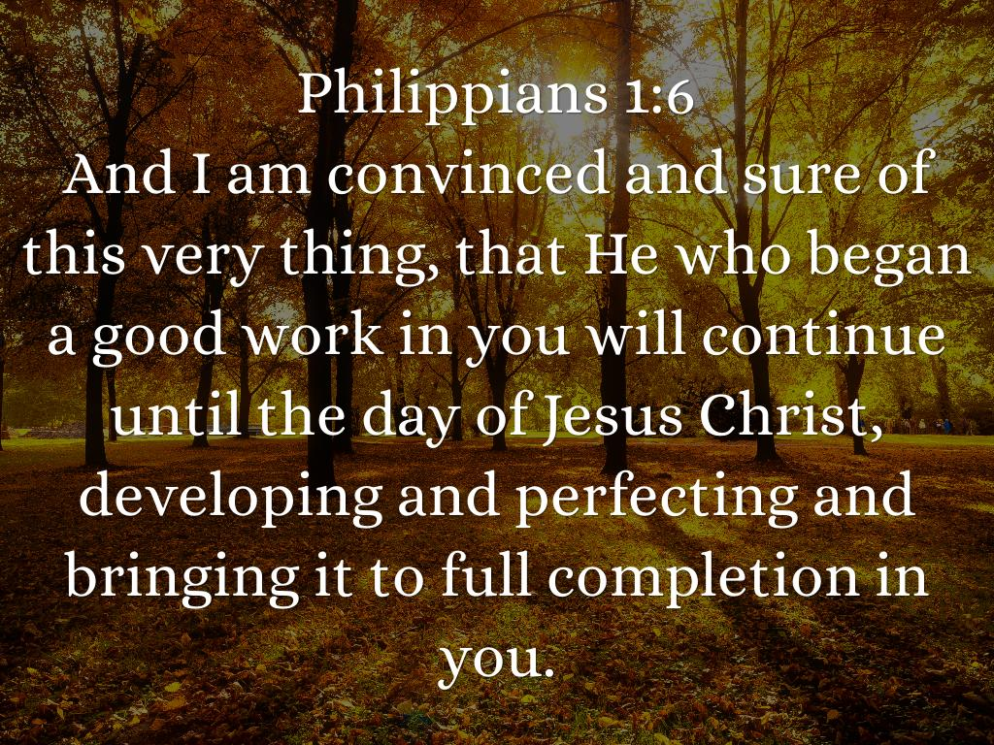

Slide 34
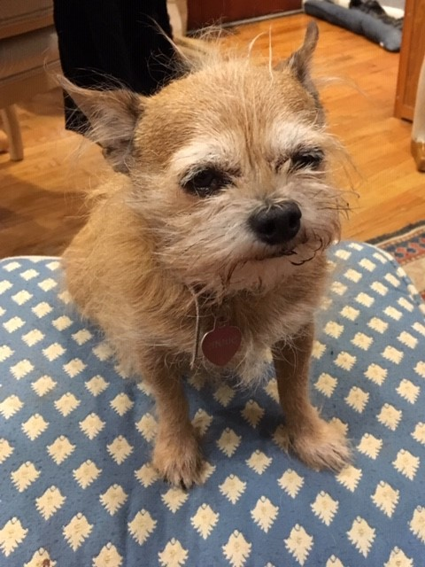
A Canine to the Ordinary Production of the Diocese of Long Island

